Slide 1
In-class Exercise 05 - Thresholding
Dhiren Gupta
-800902466

Slide 2
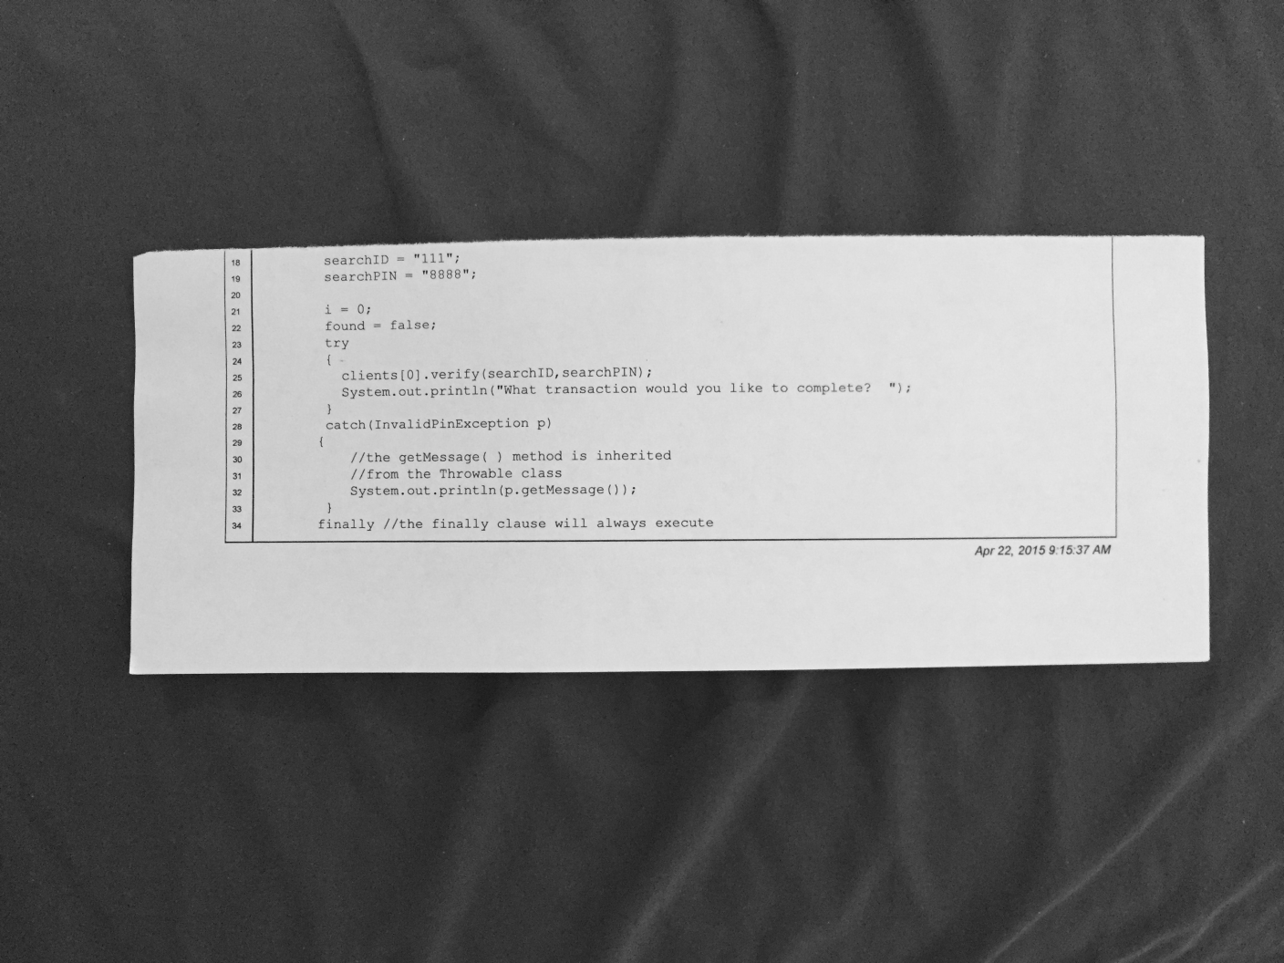
Otsu-Input Image

Slide 3
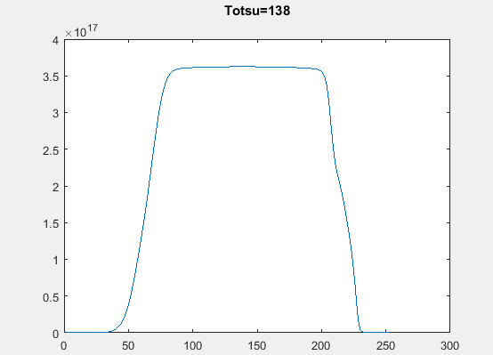
Otsu

Slide 4
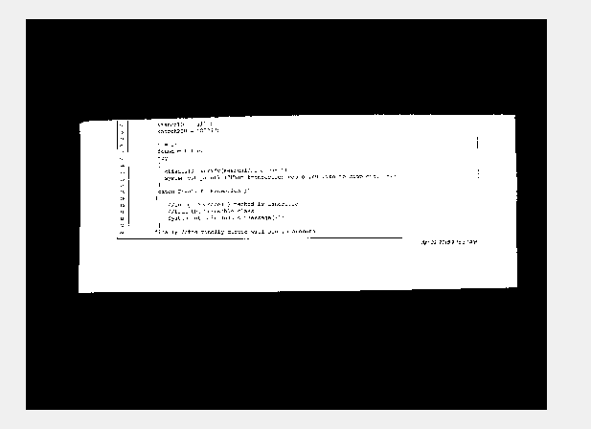
Otsu- Output Image

Slide 5
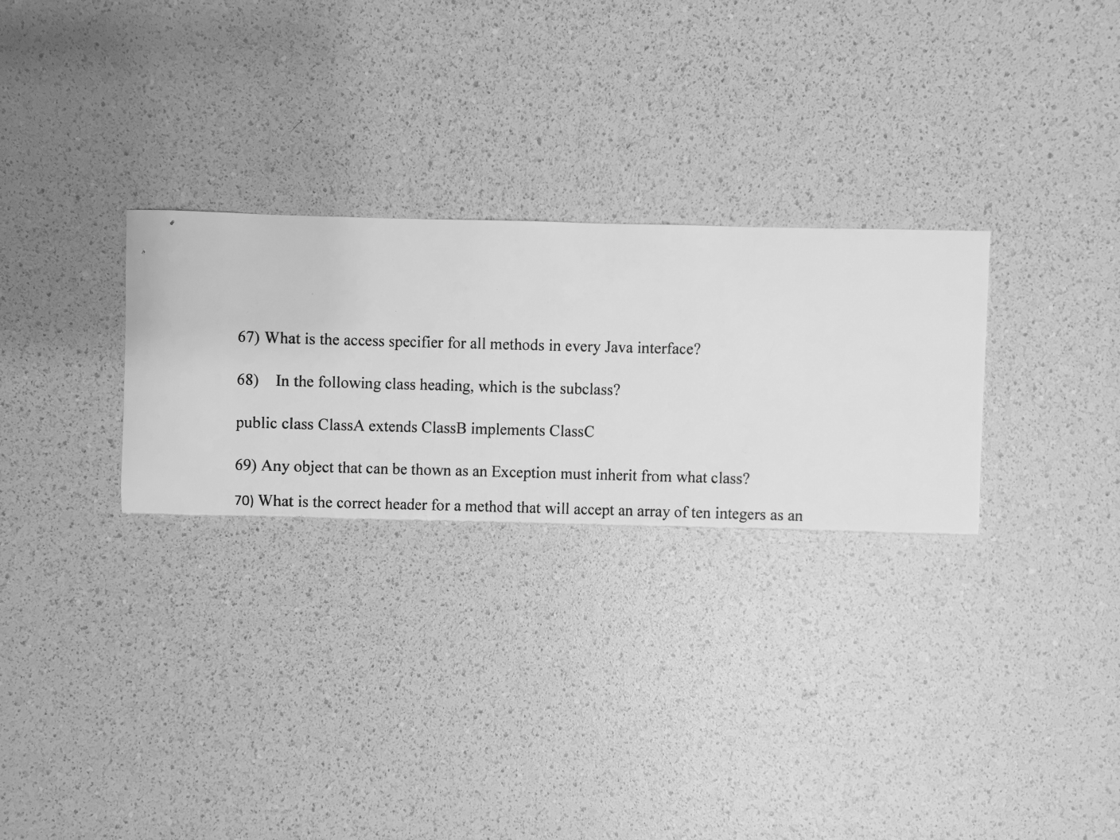
Local Threshold-Input iamge

Slide 6
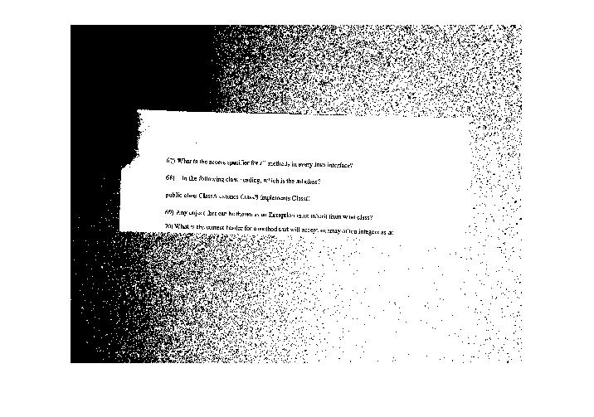
Local Threshold- o/p from Otsu

Slide 7
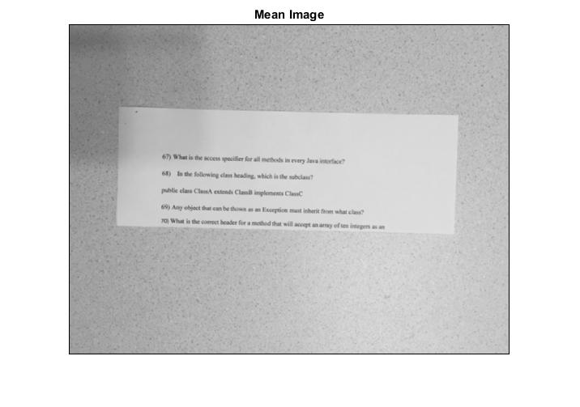
Local Threshold-Mean Image

Slide 8

Local Threshold-K=1

Slide 9
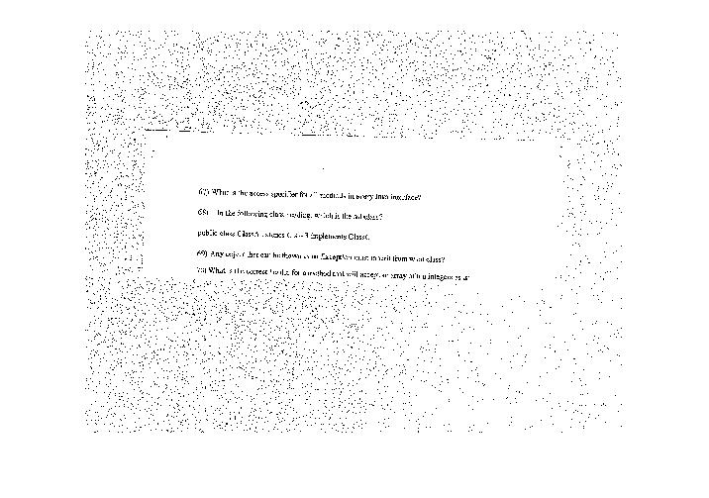
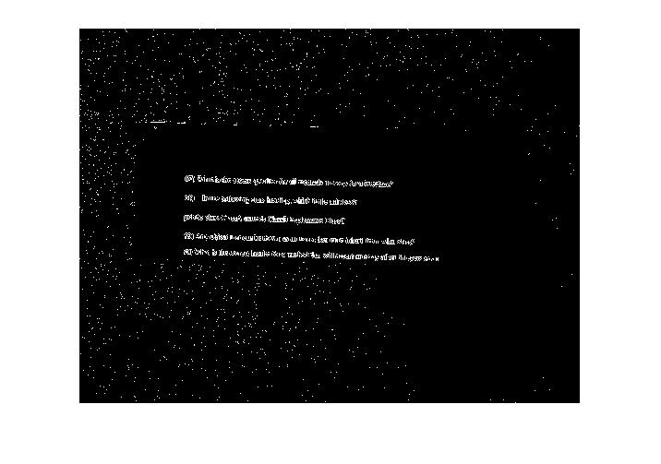
Local Threshold- with different K
K=.9
K=1.1

Slide 10
Thank You

